Slide 1
Lecture 11: Recurrent Neural Networks 2

Slide 2
Outline
Forgetting, remembering and updating (review)
Gated networks, LSTM and GRU
RNN Structures
Bidirectional
Deep RNN
Sequence to Sequence
Teacher Forcing
Attention models

Slide 3
Outline
Forgetting, remembering and updating (review)
Gated networks, LSTM and GRU
RNN Structures
Bidirectional
Deep RNN
Sequence to Sequence
Teacher Forcing
Attention models

Slide 4
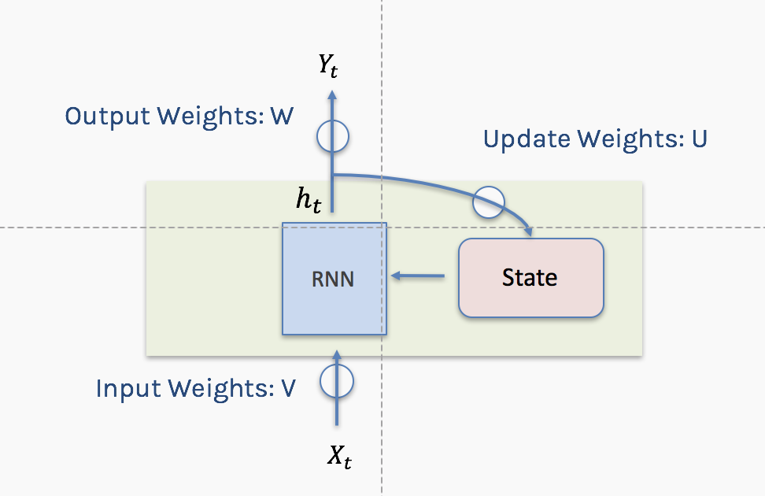
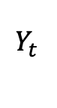
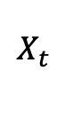
Notation
Using conventional and convenient notation
$$Y_{t }$$
$$X_{t }$$

Slide 5
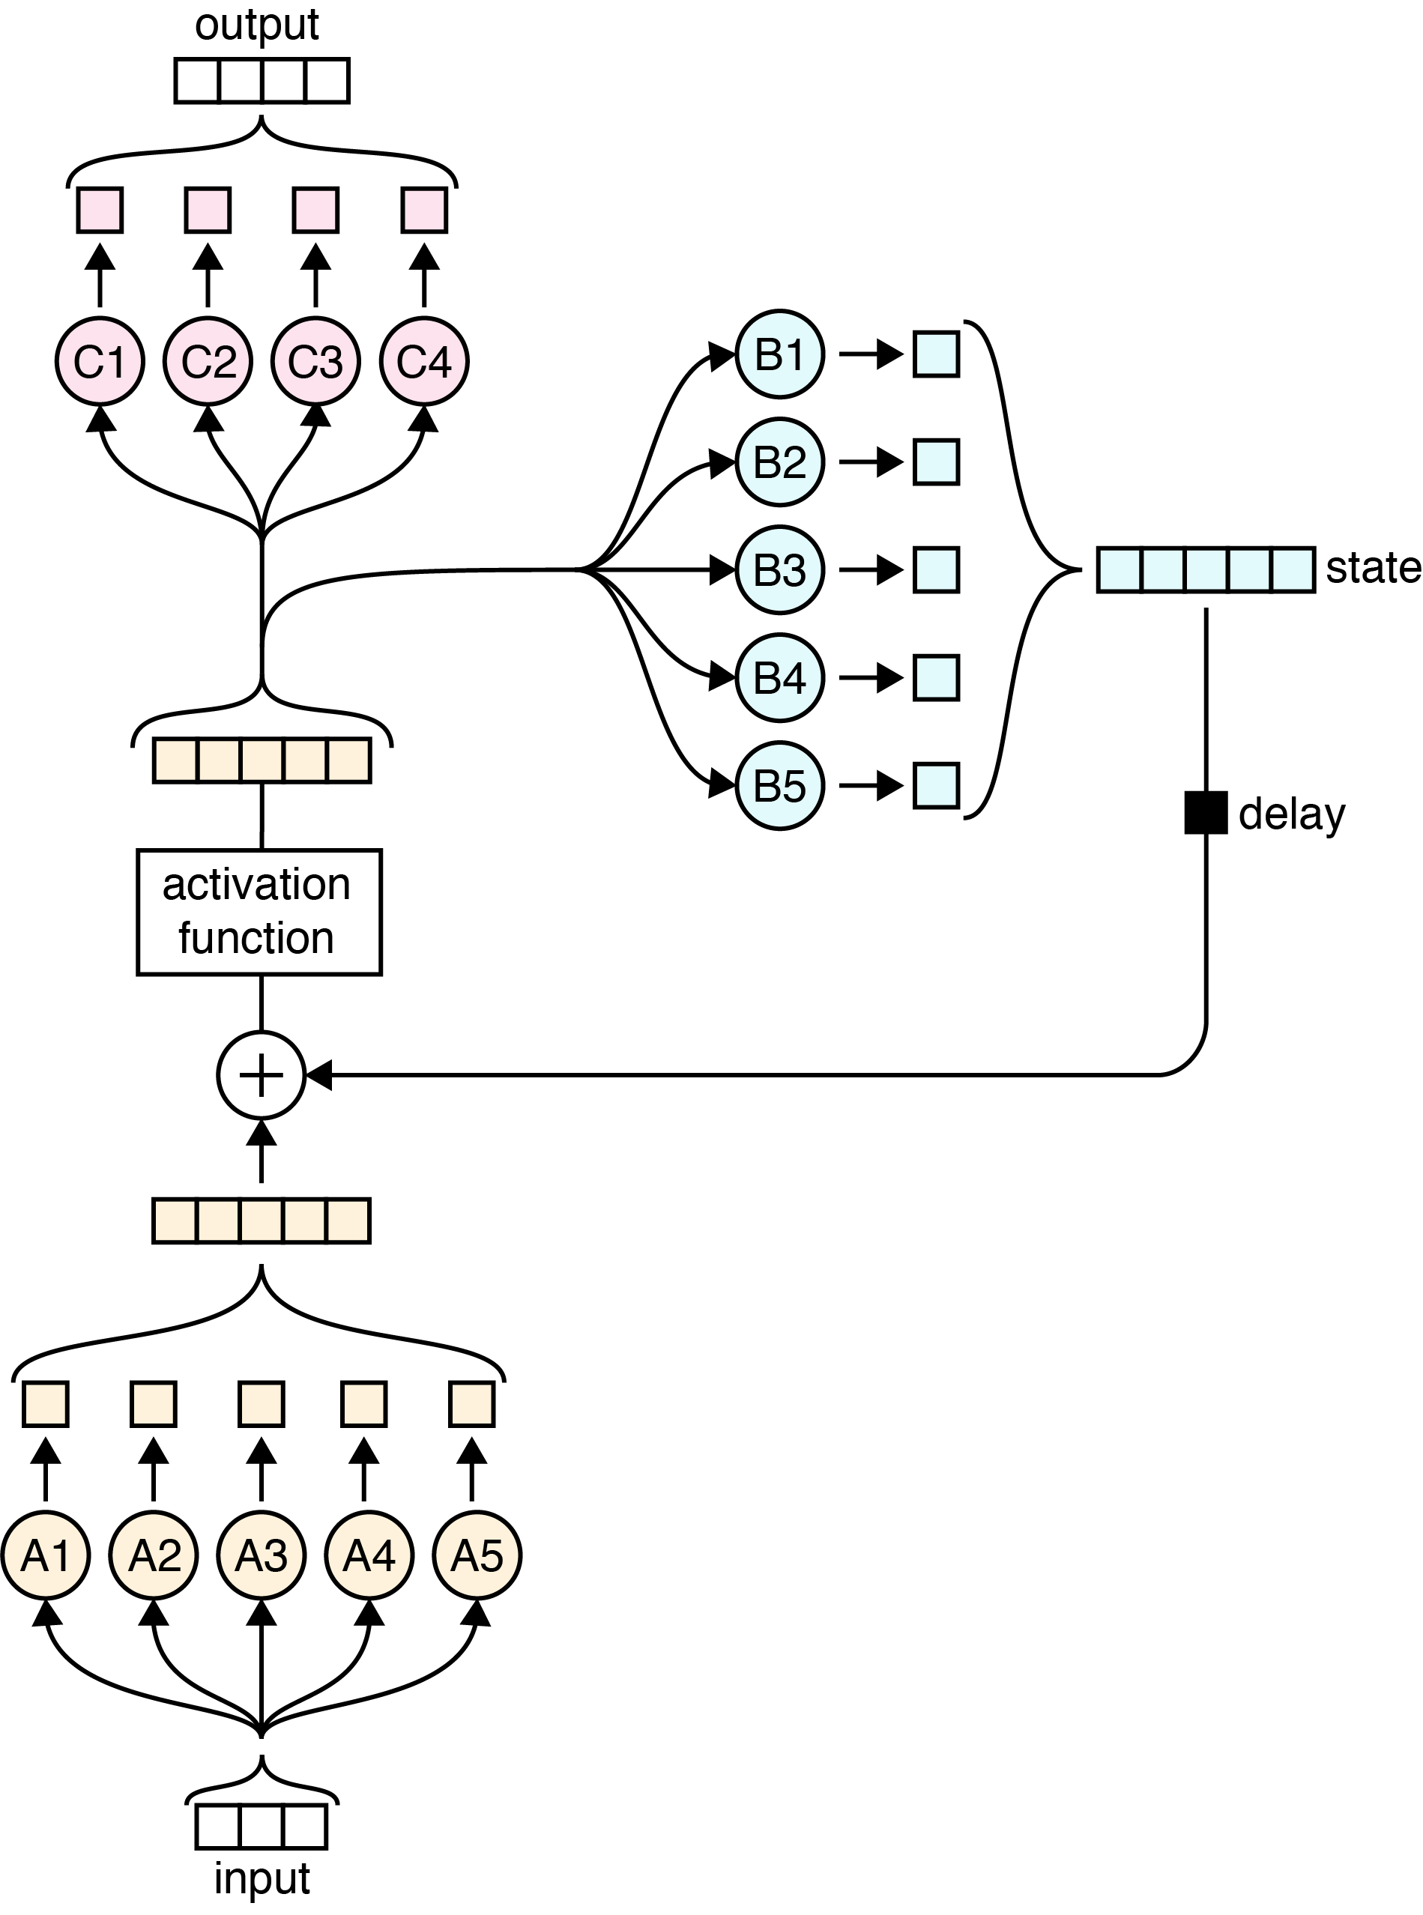
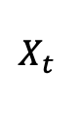
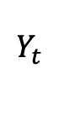
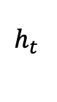
Simple RNN again
$$Y_{t }$$
σ
W
$$h_{t }$$
State
σ
+
U
V
$$X_{t }$$

Slide 6
Simple RNN again
$$Y_{t }$$
σ
W
$$h_{t }$$
State
σ
+
U
V
$$X_{t }$$

Slide 7

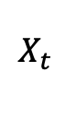
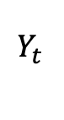
Simple RNN again: Memories
$$Y_{t }$$
σ
W
$$h_{t }$$
State
σ
+
U
V
$$X_{t }$$

Slide 8
Simple RNN again: Memories - Forgetting
$$Y_{t }$$
σ
W
$$h_{t }$$
State
σ
+
U
V
$$X_{t }$$

Slide 9
Simple RNN again: New Events
$$Y_{t }$$
σ
W
$$h_{t }$$
State
σ
+
U
V
$$X_{t }$$

Slide 10
Simple RNN again: New Events Weighted
$$Y_{t }$$
σ
W
$$h_{t }$$
State
σ
+
U
V
$$X_{t }$$

Slide 11
Simple RNN again: Updated memories
$$Y_{t }$$
σ
W
$$h_{t }$$
State
σ
+
U
V
$$X_{t }$$

Slide 12
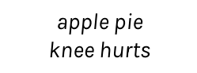
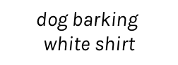
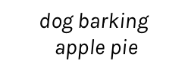
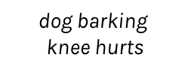
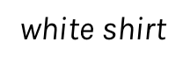
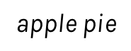
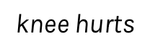
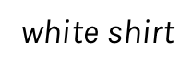
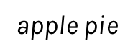
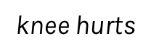
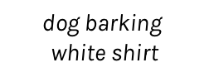
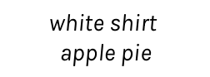
RNN + Memory
0.3
0.1
0.1
0.4
0.6
-------
-------
-------
dog barking
$$\text{dog} \text{barking}$$
$$\text{white} \text{shirt}$$
$$\text{white} \text{shirt}$$
$$\text{apple} \text{pie}$$
$$\text{apple} \text{pie}$$
$$\text{knee} \text{hurts}$$
RNN
RNN
RNN
RNN
RNN
dog barking
$$\text{white} \text{shirt}$$
$$\text{apple} \text{pie}$$
$$\text{knee} \text{hurts}$$
get dark
0.3
0.1
0.1
0.6
0.9
-------
-------
-------
dog barking
$$\text{dog} \text{barking}$$
$$\text{white} \text{shirt}$$
$$\text{dog} \text{barking}$$
$$\text{apple} \text{pie}$$
$$\text{dog} \text{barking}$$
$$\text{knee} \text{hurts}$$
RNN
RNN
RNN
RNN
RNN
dog barking
$$\text{white} \text{shirt}$$
$$\text{apple} \text{pie}$$
$$\text{knee} \text{hurts}$$
get dark

Slide 13
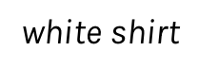
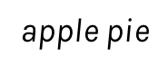
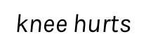
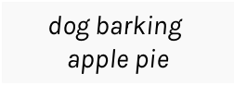
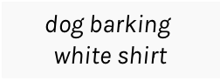
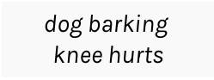
RNN + Memory + Output
0.3
0.1
0.1
0.6
0.9
-------
-------
-------
dog barking
$$\text{dog} \text{barking}$$
$$\text{white} \text{shirt}$$
$$\text{dog} \text{barking}$$
$$\text{apple} \text{pie}$$
$$\text{dog} \text{barking}$$
$$\text{knee} \text{hurts}$$
RNN
RNN
RNN
RNN
RNN
dog barking
$$\text{white} \text{shirt}$$
$$\text{apple} \text{pie}$$
$$\text{knee} \text{hurts}$$
get dark

Slide 14
Outline
Forgetting, remembering and updating (review)
Gated networks, LSTM and GRU
RNN Structures
Bidirectional
Deep RNN
Sequence to Sequence
Teacher Forcing
Attention models

Slide 15

LSTM: Long short term memory

Slide 16
Gates
A key idea in the LSTM is a mechanism called a gate.

Slide 17
Forgetting
Each value is multiplied by a gate, and the result is stored back into the memory.

Slide 18
Remembering
Remembering involves two steps.
We determine how much of each new value we want to remember and we use gates to control that.
Remember the gated values, we merely add them in to the existing contents of the memory.

Slide 19
Remembering (cont)

Slide 20
Updating
To select from memory we just determine how much of each element we want to use, we apply gates to the memory elements, and the results are a list of scaled memories.

Slide 21
LSTM
C_{t-1}
C_{t}
h_{t-1}
h_{t}
Notes:
Finite state machines

Slide 22
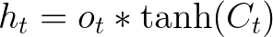
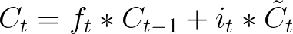
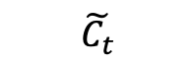
Before to really understand LSTM lets see the big picture …
Forget Gate
C_{t-1}
C_{t}
Output Gate
f_{t}
i_{t}
o_{t}
$$\tilde{C_{t}}$$
h_{t-1}
h_{t}
Input Gate
Cell State

Slide 23
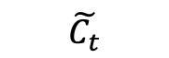
LSTM are recurrent neural networks with a cell and a hidden state, boths of these are updated in each step and can be thought as memories.
Cell states work as a long term memory and the updates depends on the relation between the hidden state in t -1 and the input.
The hidden state of the next step is a transformation of the cell state and the output (which is the section that is in general used to calculate our loss, ie information that we want in a short memory).
C_{t-1}
C_{t}
f_{t}
i_{t}
o_{t}
$$\tilde{C_{t}}$$
h_{t-1}
h_{t}

Slide 24
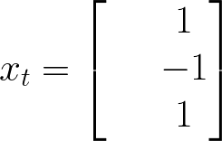

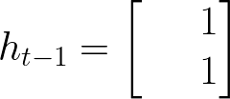
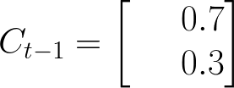

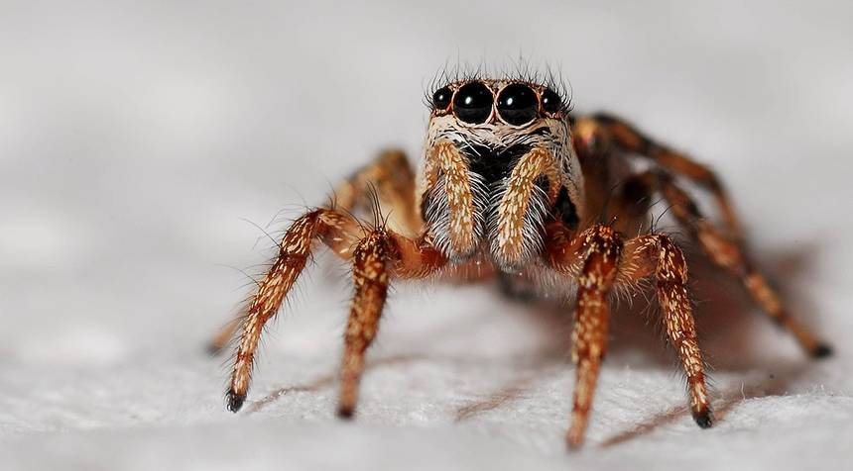


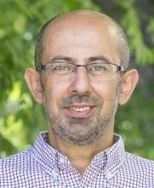
Let's think about my cell state
Let's predict if I will help you with the homework in time t

Slide 25
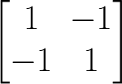
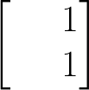
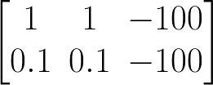
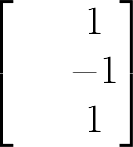
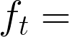
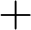

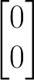
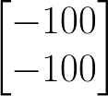
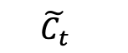
Forget Gate
The forget gate tries to estimate what features of the cell state should be forgotten.
C_{t-1}
C_{t}
i_{t}
o_{t}
f_{t}
$$\tilde{C_{t}}$$
h_{t-1}
h_{t}
Erase everything!

Slide 26
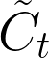
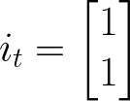
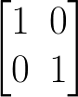
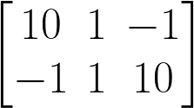
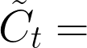



The input gate layer works in a similar way that the forget layer, the input gate layer estimates the degree of confidence of . is a new estimation of the cell state.
Input Gate
Let’s say that my input gate estimation is:
C_{t-1}
C_{t}
i_{t}
o_{t}
f_{t}
$$\tilde{C_{t}}$$
h_{t-1}
h_{t}

Slide 27

Cell state
After the calculation of forget gate and input gate we can update our new cell state.
C_{t-1}
C_{t}
i_{t}
o_{t}
f_{t}
$$\tilde{C_{t}}$$
h_{t-1}
h_{t}
27

Slide 28





Output gate
The output gate layer is calculated using the information of the input x in time t and hidden state of the last step.
It is important to notice that the hidden state used in the next step is obtained using the output gate layer which is usually the function that we optimize.
C_{t-1}
C_{t}
i_{t}
o_{t}
f_{t}
$$\tilde{C_{t}}$$
h_{t-1}
h_{t}

Slide 29
GRU
A variant of the LSTM is called the Gated Recurrent Unit, or GRU.
The GRU is like an LSTM but with some simplifications.
The forget and input gates are combined into a single gate
No cell state
Since there’s a bit less work to be done, a GRU can be a bit faster than an LSTM. It also usually produces results that are similar to the LSTM.
Note: Worthwhile to try both the LSTM and GRU to see if either provides more accurate results for a data set.

Slide 30


GRU (cont)
C_{t-1}
C_{t}
i_{t}
o_{t}
f_{t}
$$\tilde{C_{t}}$$
h_{t-1}
h_{t}

Slide 32







wcct! = we can calculate this!
To optimize my parameters i basically need to do:
Let’s calculate all the derivatives in some time t!
wcct!
wcct!
wcct!
wcct!
So… every derivative is wrt the cell state or the hidden state

Slide 33



Let’s calculate the cell state and the hidden state

Slide 34

RNN Structures
$$Y_{t }$$
The one to one structure is useless.
It takes a single input and it produces a single output.
Not useful because the RNN cell is making little use of its unique ability to remember things about its input sequence
$$X_{t }$$
one to one

Slide 35


RNN Structures (cont)
$$Y_{t }$$
﻿The many to one structure reads in a sequence and gives us back a single value.
Example: Sentiment analysis, where the network is given a piece of text and then reports on some quality inherent in the writing. A common example is to look at a movie review and determine if it was positive or negative. (see lab on Thursday)
$$X_{t−2 }$$
$$X_{t−1 }$$
$$X_{t }$$
many to one

Slide 36




RNN Structures (cont)
$$Y_{t−2 }$$
$$Y_{t−1 }$$
$$Y_{t }$$
The one to many takes in a single piece of data and produces a sequence.
For example we give it the starting note for a song, and the network produces the rest of the melody for us.
$$X_{t−2 }$$
one to many

Slide 37


RNN Structures (cont)
$$Y_{t−2 }$$
$$Y_{t−1 }$$
$$Y_{t }$$
The many to many structures are in some ways the most interesting.
Example: Predict if it will rain given some inputs.
$$X_{t−2 }$$
$$X_{t−1 }$$
$$X_{t }$$
many to many

Slide 38
RNN Structures (cont)
$$Y_{t−1 }$$
$$Y_{t }$$
This form of many to many can be used for machine translation.
For example, the English sentence: “The black dog jumped over the cat”
In Italian as:
“Il cane nero saltò sopra il gatto”
In the Italia, the adjective “nero” (black) follows the noun “cane” (dog), so we need to have some kind of buffer so we can produce the words in their proper English.
$$X_{t−2 }$$
$$X_{t−1 }$$
many to many

Slide 39
Bidirectional
RNNs (LSTMs and GRUs) are designed to analyze sequence of values.
For example: ﻿Srivatsan said he needs a vacation.
he here means Srivatsan and we know this because the word Srivatsan was before the word he.
However consider the following sentence:
He needs to work harder, Pavlos said about Srivatsan.
He here comes before Srivatsan and therefore the order has to be reversed or combine forward and backward.
These are called bidirectional RNN or BRNN or bidirectional LSTM or BLSTM when using LSTM units (BGRU etc).

Slide 40





Bidirectional (cond)
$$Y_{t−2 }$$
$$Y_{t−1 }$$
$$Y_{t }$$
﻿symbol for a BRNN
$$Y_{t }$$
previous state
previous state
$$X_{t }$$
$$X_{t−2 }$$
$$X_{t−1 }$$
$$X_{t }$$

Slide 41
Deep RNN
LSTM units can be arranged in layers, so that each the output of each unit is the input to the other units. This is called a deep RNN, where the adjective “deep” refers to these multiple layers.
Each layer feeds the LSTM on the next layer
First time step of a feature is fed to the first LSTM, which processes that data and produces an output (and a new state for itself).
That output is fed to the next LSTM, which does the same thing, and the next, and so on.
Then the second time step arrives at the first LSTM, and the process repeats.

Slide 42







Deep RNN
$$Y_{ }$$
$$Y_{t−2 }$$
$$Y_{t−1 }$$
$$Y_{t }$$
$$Y_{t+1 }$$
$$Y_{t+2 }$$
$$X_{ }$$
$$X_{t−2 }$$
$$X_{t−1 }$$
$$X_{t }$$
$$X_{t+1 }$$
$$X_{t+2 }$$

Slide 43
Sequence to Sequence
Sebastien lived in France.
Seq2seq model learns from variable sequence input fixed length sequence output. It uses two LSTM model, one learns vector representation from input sequence of fixed dimensionality and another LSTM learns to decode from this input vector to target sequence.

Slide 44

Sequence to Sequence (cont)

Slide 45
What is Teacher Forcing (cont)
Models that have recurrent connections from their outputs leading back into the model may be trained with teacher forcing.
— Page 372, Deep Learning, 2016.
Teacher forcing is a procedure […] in which during training the model receives the ground truth output y(t) as input at time t + 1.
— Page 372, Deep Learning, 2016.

Slide 46
What is Teacher Forcing (cont)
Given the following input sequence:
“The wheels on the bus go round and round.”
In this task we want to train a model to generate the next word in the sequence given the previous sequence of words.
We add a token to signal the start of the sequence and another to signal the end of the sequence. We will use “[START]” and “[END]” respectively.
“[START] The wheels on the bus go round and round [END]

Slide 47
What is Teacher Forcing (cont)
Imagine the model generates the word “A“, but of course, we expected “The“.
The model is off track and is going to get punished for every subsequent word it generates. This makes learning slower and the model unstable.
Instead, we can use teacher forcing.
In the first example when the model generated “A” as output, we can discard this output after calculating error and feed in “The” as part of the input on the subsequent time step.

Slide 48
What is Teacher Forcing (cont)
In the first example when the model generated “A” as output, we can discard this output after calculating error and feed in “The” as part of the input on the subsequent time step.
[START], ?
[START], The, wheels ?
[START], The, wheels, on , ?
[START], The, wheels, on , the, ?
...
REMEMBER: ONLY IN TRAINING TIME

Slide 49

Notes:
LiveSlide Site
https://blog.openai.com/better-language-models/

Slide 50
Attention models
Sebastien lived in France.
Back in Sebastien’s days at France, he lived in the city of Paris, a city of great beauty and filled with love and beautiful art, and he spoke French, a language with great history and the national language of France.
Back in Sebastien’s days at France, =>
he lived in the city of Paris, =>
a city of great beauty and filled with love and beautiful art, =>
and he spoke French, a language with great history and the national language of France.

Slide 51

Attention models
When translating a sentence, you pay attention to the word that is presently translated.
When transcribing an audio recording, you listen carefully to the segment you are actively writing down.
To describe the room you are in, you describe the objects in that room.
https://distill.pub/2016/augmented-rnns/

Slide 52
Attention models (cont)
This attention is generated with content-based attention. The attending RNN generates a query describing what it wants to focus on. Each item is multiplied (dot product) with the query to produce a score, describing how well it matches the query. The scores are fed into a softmax to create the attention distribution.
Source – https://github.com/google/seq2seq

Slide 53

Attention models (cont)

Slide 54
Notes:
LiveSlide Site
https://distill.pub/2016/augmented-rnns/

